Slide 1
Color Image Transformation

Slide 2
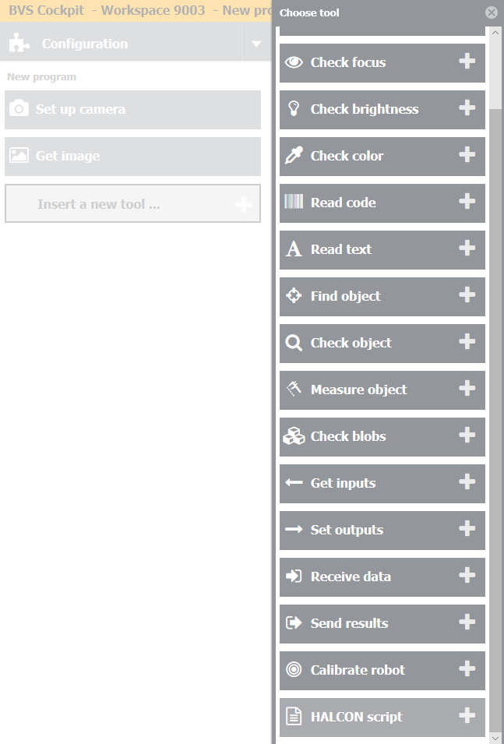
Step 1
Add new tool – Halcon Script – in your inspection program.

Slide 3
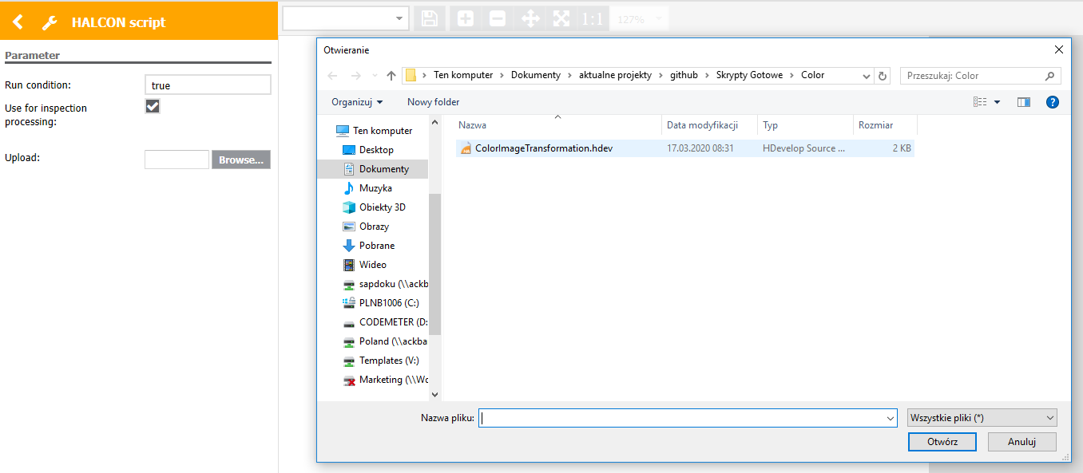
Step 2
Click „Browse” and choose „ColorImageTransformation.hdev” file.

Slide 4
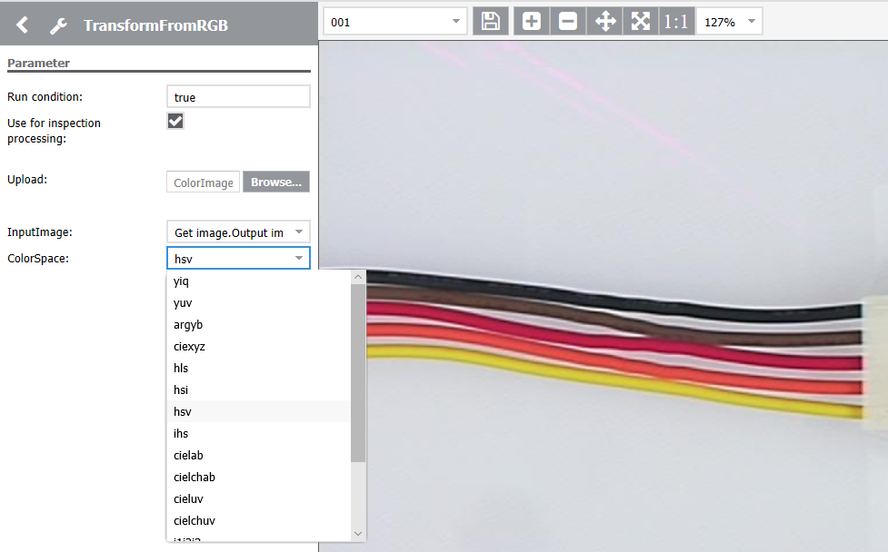
Step 3
Choose the desired color space.

Slide 5
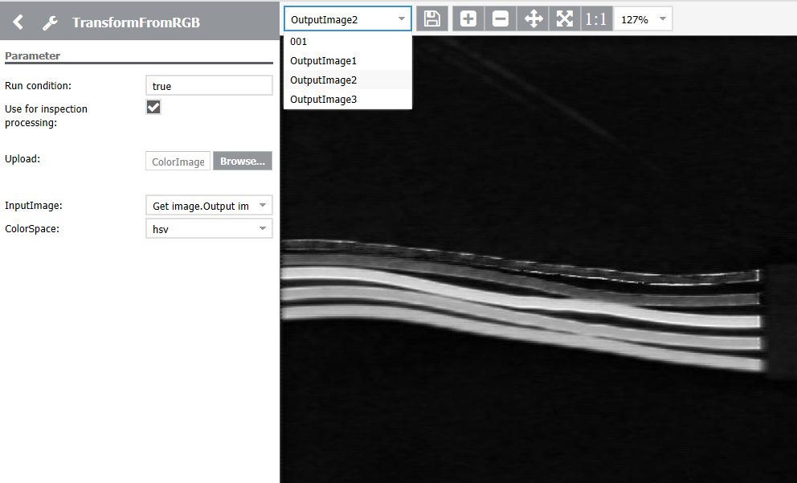
Step 4
As an output you will get three images which you can use in the following tools.

